Slide 1
Twitter Followers Network Analysis and Recommendation model
Team 6
Ananya Sajwan – 18BCE1355
CSE3021 - Social Information Networks A1 SLOT
J-Component Review 2

Slide 2
ABSTRACT
Nowadays, social media platforms like Facebook, Twitter, Instagram etc. have become a very important part of our daily lives and such platforms provide a plethora of data.
This data can be analysed using various social analysis models and techniques to gain insights and recommendations.
The main aim of the project is to use Python and NetworkX to analyse Twitter communities and followers using social network analysis techniques and also provide recommendations for new followers/communities on Twitter based on the Network Analysis.

Slide 3
01
02
03
Python
Tweepy
Twitter API
04
05
06
Community Detection Algorithms
Recommendations
NetworkX & igraph
TECH STACK
The code will be deployed using Python on Jupyter Notebook
Open source Python library for accessing Twitter API
This will be used to get data of people/communities from Twitter directly
Algorithms like Eigen Vector, Multilevel & Latent propagation and comparing the results
Python libraries for social network analysis using graphs/networks
Suggest top communities/people to follow based on graph analysis

Slide 4
Algorithms
For community detection, 3 major algorithms will be used and the obtained results will be compared:
Leading Eigen Vector
Multilevel
Label Propagation
These algorithms are selected since they have varying approaches to social network analysis and will provide different results for metrics like modularity for graphical analysis of Twitter followers and communities.

Slide 5
Algorithms
Multilevel algorithm is commonly recommended for social network analysis of large networks like Twitter hence it is selected for this project.
Leading Eigen Vector algorithm works by calculating the eigenvector of the modularity matrix for largest positive eigenvalue and then separating vertices into the community structure.
Label propagation is one of the fastest algorithms and uses labelling for community detection hence it has been included as one of the algorithms for this project.

Slide 6
Process Flow
Crawling Twitter users data (basic info, followers and most popular hashtags) using Tweepy and Twitter API.
Declaring functions for collecting and processing the data (friends & followers) into a pickle file for easy & fast use.
Creating visual graphs based on crawled data and dataset available using NetworkX and iGraph.
Detecting communities in the created graph using the 3 main community detection algorithms.
Performing recommendation using graph based techniques with the help of NetworkX.

Slide 7

Details of Dataset
The data for the project is obtained by scraping real time user Twitter data using Tweepy and Twitter API.
Use of the Twitter API is obtained by creating a twitter developer account and obtaining the authorization keys and secret keys (4 in total) for connecting and using the API.
Crawling the data is a long process, and for a small user account it took exactly 2d 22h 43min 17s.
Crawled data saved as a pickle file and can be used for analysis directly.

Slide 8
RESULTS

Slide 9
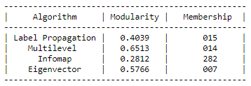
Community Detection Algorithms

Slide 10
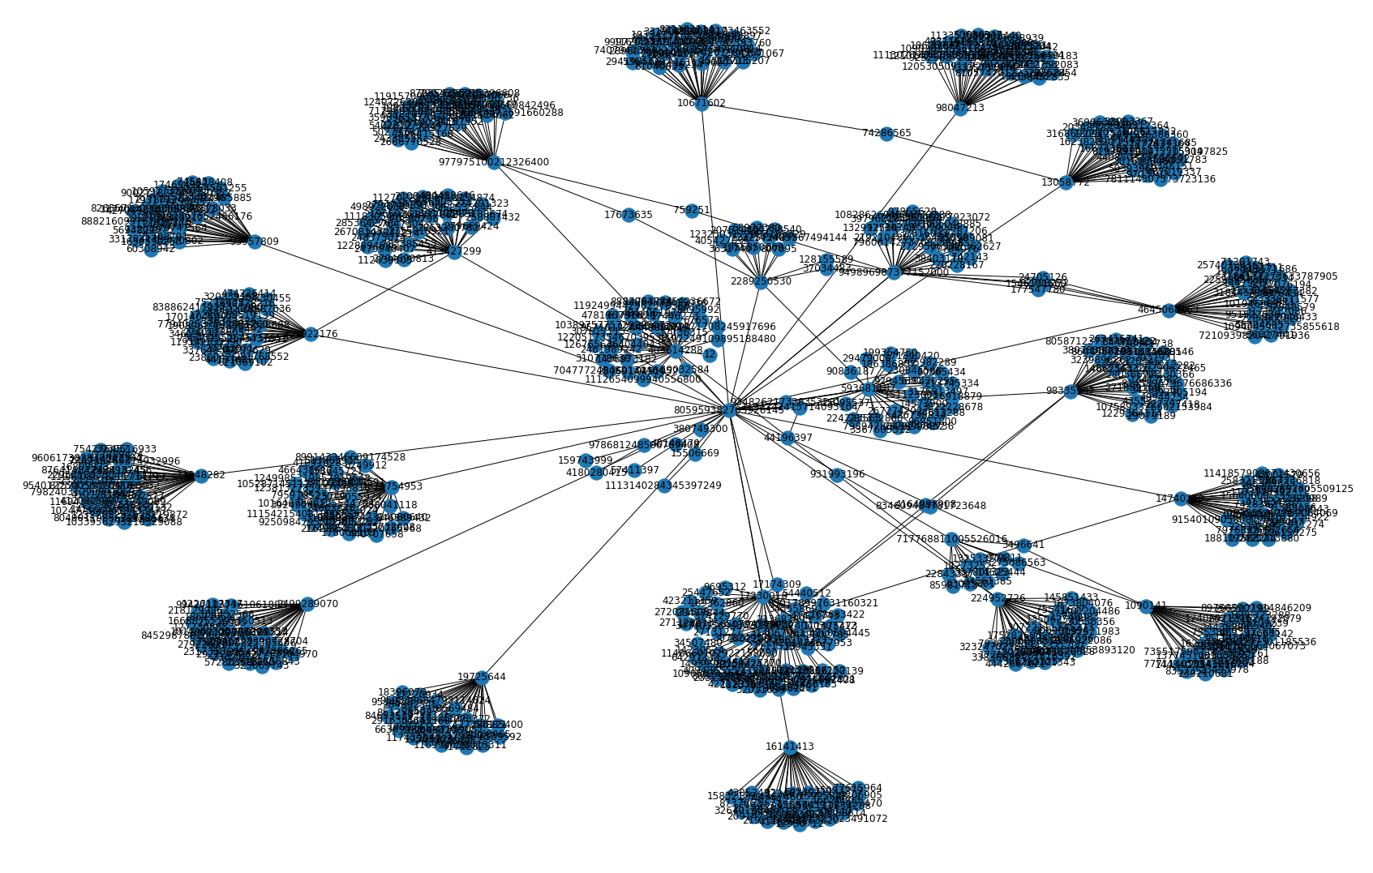
Plotting Social Network for Limited Followers

Slide 11
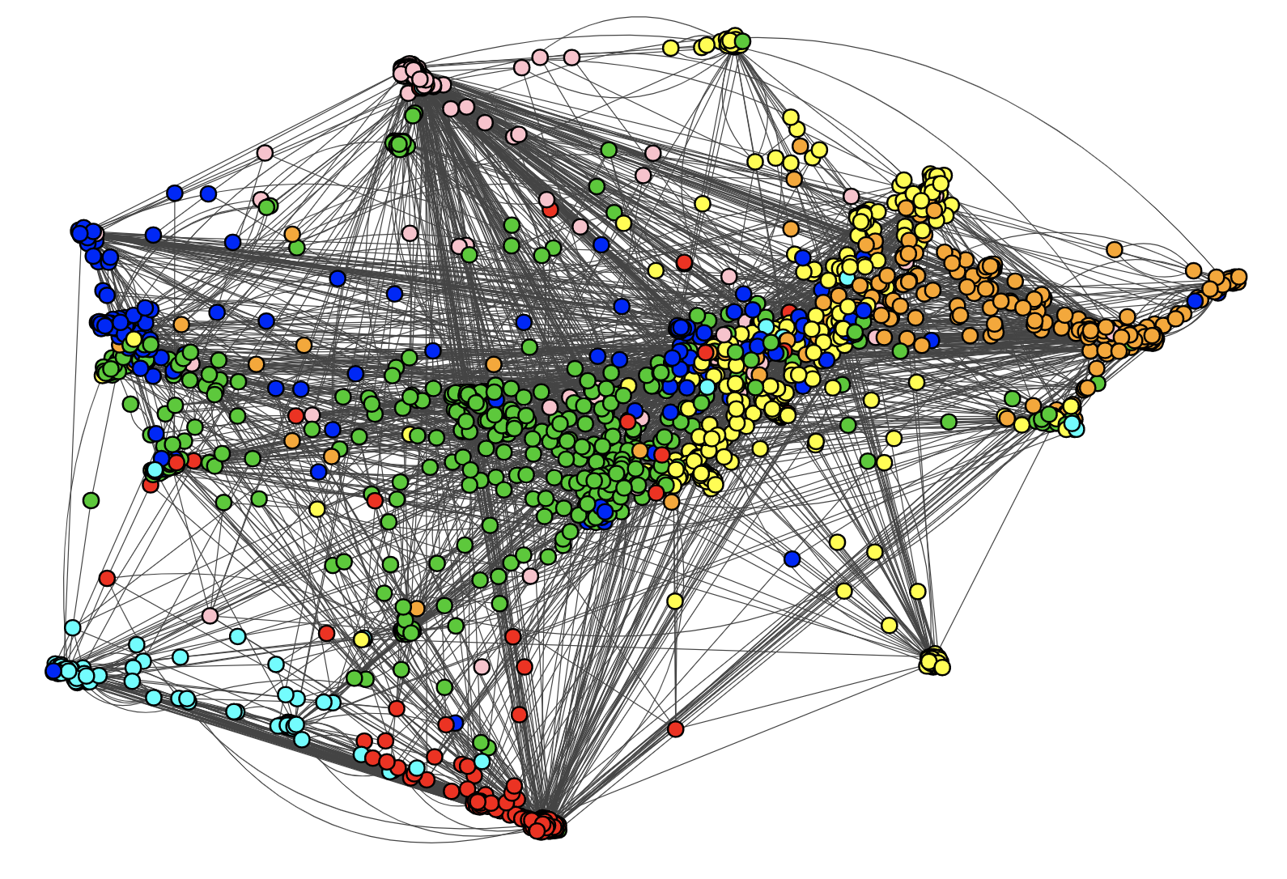
Community Detection using Leading Eigenvector Algorithm

Slide 12
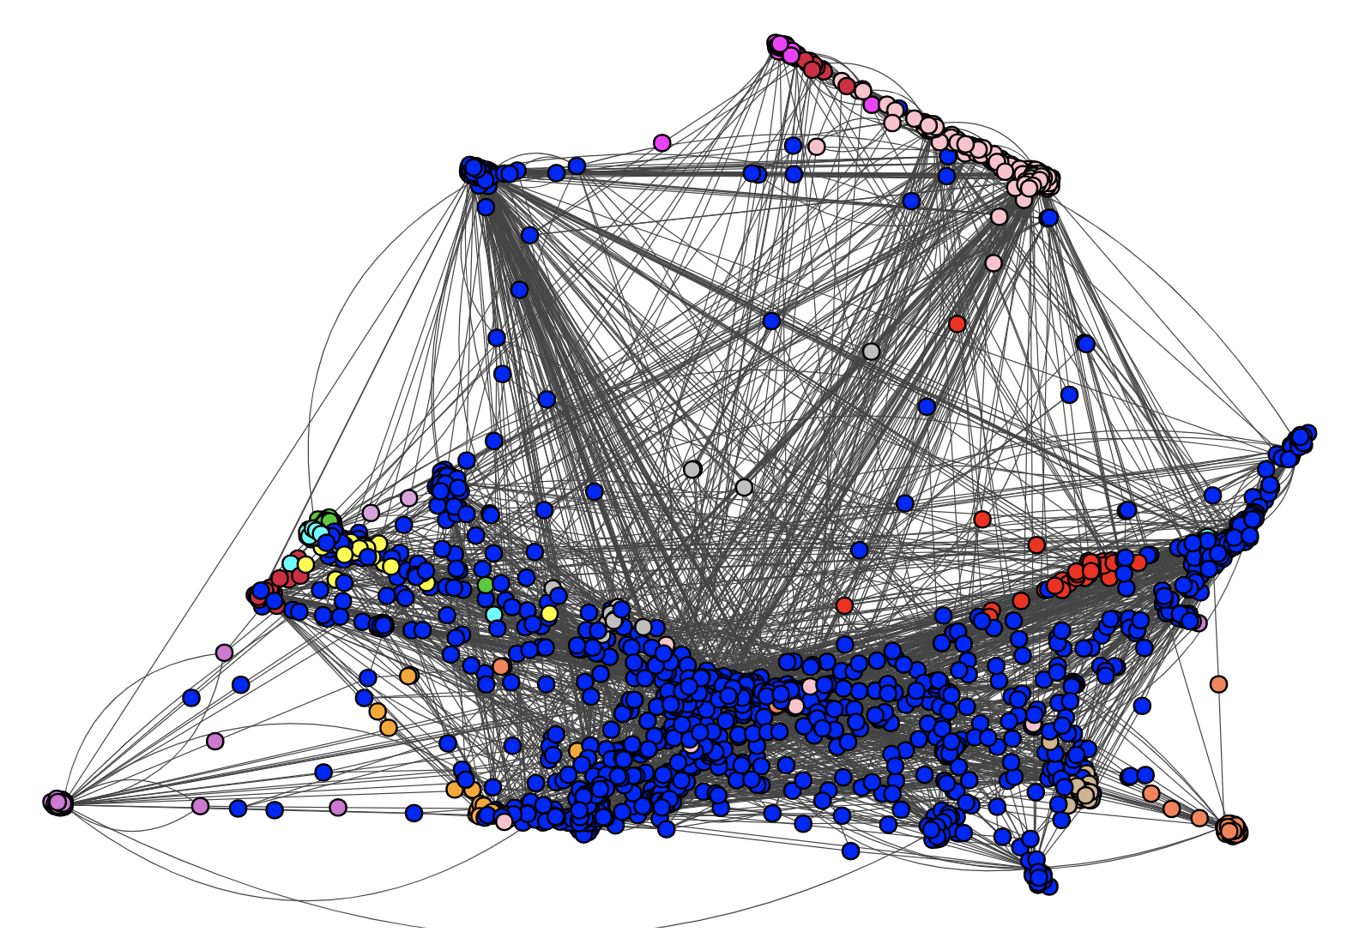
Community Detection using Label Propagation Algorithm

Slide 13
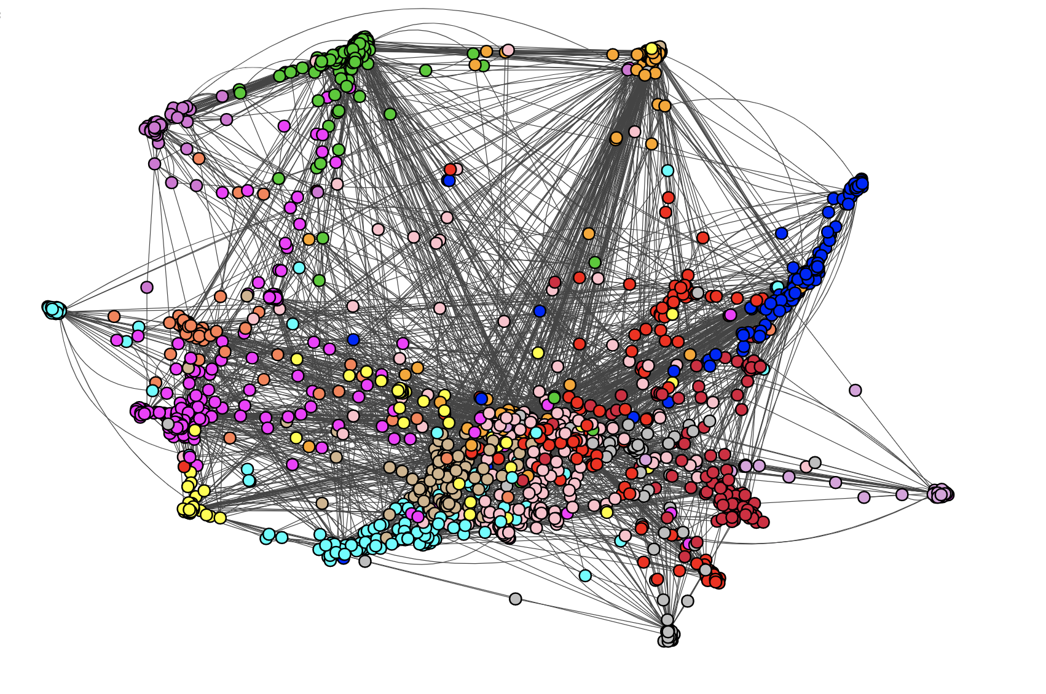
Community Detection using Multilevel Algorithm

Slide 14
CURRENT PROGRESS & AIM FOR REVIEW 3
Currently, 80% of the project is completed which includes scraping of Twitter data using the Twitter API and processing it to get analysis graphs using NetworkX and iGraph libraries.
The comparison of various community detection algorithms on the scraped data in terms of modularity, membership and iGraph plots is also completed.
For the final review, the recommendation component based on the social network analysis done will be completed and demoed.

Slide 15
CONCLUSION
The result thus will be a complete notebook having:
Twitter data scraping via Tweepy and Twitter API
Twitter data pre-processing and exploratory data analysis.
Community and Followers graph construction.
Comparison of the 3 community detection algorithms selected.
Follower/Community recommendation based on graph analysis.
The novelty of the project includes the realtime web scraping of Twitter data, comparison of the 3 major community detection algorithms and recommendations of new followers/communities based on graph analysis.

Slide 16
THANK YOU !

